Slide 1
A PURIFYING HOPE
BY PASTOR GEORGE PAUL OFORI

Slide 2
SDAH 109-MARVELOUS GRACE ENGLISH TWI
Marvellous grace of our loving Lord.
Grace that exceeds our sin and our guilt!
Yonder on Calvary's mount outpoured
There where the blood of the Lamb was spilt.
Yεn Aw’rade dכfo dom nwanwa,
כdom a εb’ro yεn bכne so,
A wohwie guu Kalbre bepכ so
‘Hכna wohwiee ‘Guammaa mogya gui.

Slide 3
SDAH 109-MARVELOUS GRACE ENGLISH TWI
Refrain:
Grace, grace, God's grace,
Grace that will pardon and cleanse within
Grace, grace, God's grace,
Grace that is greater than all our sin!
Nnyeso:
‘Dom, ‘dom, ‘S’ro ‘dom,
‘Dom a εde bכn’ kyε, tew yεn mu;
‘Dom, ‘dom, ‘S’ro ‘dom,
‘Dom a εb’ro bכne nyinaa so.

Slide 4
SDAH 109-MARVELOUS GRACE ENGLISH TWI
Sin and despair, like the sea waves cold,
Threaten the soul with infinite loss;
Grace that is greater yes grace untold
Points to the Refuge, the mighty Cross.
Bכne ne abasamtu te sε
‘S’rכkye de כy’ra huna kra no;
כdom kεse, nea enni kabea
Kyerε yεn guankכbea ‘sεnnua no.

Slide 5
SDAH 109-MARVELOUS GRACE ENGLISH TWI
Refrain:
Grace, grace, God's grace,
Grace that will pardon and cleanse within
Grace, grace, God's grace,
Grace that is greater than all our sin!
Nnyeso:
‘Dom, ‘dom, ‘S’ro ‘dom,
‘Dom a εde bכn’ kyε, tew yεn mu;
‘Dom, ‘dom, ‘S’ro ‘dom,
‘Dom a εb’ro bכne nyinaa so.

Slide 6
SDAH 109-MARVELOUS GRACE ENGLIsh TWI
Marvellous, infinite, matchless grace,
Freely bestowed on all who believe!
You that are longing to see His face,
Will you this moment His grace receive?
כdom nwanwa a enni kabea,
Wכde ma nea כgye di no kwa!
Mo a morep’re ahu N’anim,
So mobεgye Ne dom no seesei?

Slide 7
SDAH 109-MARVELOUS GRACE ENGLISH TWI
Refrain:
Grace, grace, God's grace,
Grace that will pardon and cleanse within
Grace, grace, God's grace,
Grace that is greater than all our sin!
Nnyeso:
‘Dom, ‘dom, ‘S’ro ‘dom,
‘Dom a εde bכn’ kyε, tew yεn mu;
‘Dom, ‘dom, ‘S’ro ‘dom,
‘Dom a εb’ro bכne nyinaa so.

Slide 8
1 Yohane 3:1 - ASWDC
1. Monhwɛ ɔdɔ ko a Agya no de adɔ yɛn, sɛ wɔmfrɛ yɛn Nyankopɔn mma, na yɛyɛ nso. Yei nti wiase nhu yɛn, ɛfiri sɛ ɛnhunuu no.

Slide 9
1 Yohane 3:2 - ASWDC
2. Adɔfo, afei yɛyɛ Nyankopɔn mma, na deɛ yɛbɛyɛ no nnya nnaa adi. Na yɛnim sɛ, sɛ ɔyi ne ho adi a, yɛbɛyɛ sɛ ɔno, ɛfiri sɛ yɛbɛhu no sɛdeɛ ɔteɛ.

Slide 10
1 Yohane 3:3 - ASWDC
3. Na obiara a ɔwɔ ne ho anidasoɔ yi no, ɔte ne ho sɛdeɛ ɔno ho teɛ.

Slide 11
INTRODUCTION
It's about the Second Coming.
We are waiting for His second coming, we are waiting for His appearing.
And it is this hope that purifies us.

Slide 12
INTRODUCTION
Purification, holiness, righteousness obviously is the expectation of our God, it is what sanctification is.
It is the progressive decrease of sin and increase of holiness.

Slide 13
Romafoɔ 12:1 - ASWDC
1. Enti, anuanom, megyina Nyankopɔn mmɔborɔhunu so metu mo fo sɛ momfa mo nipadua nsi hɔ sɛ afɔdeɛ a ɛte aseɛ, a ɛyɛ kronkron a ɛsɔ Nyankopɔn ani, a ɛne mo nyamesom a adwene wɔ mu no.

Slide 14
2 Korintofoɔ 7:1 - ASWDC
1. Afei sɛ yɛwɔ saa bɔhyɛ yi nti, adɔfoɔ, momma yɛnhohoro yɛn ho mfiri honam ne honhom mu fi nyinaa ho, na yɛawie yɛn ahoteɛ Onyankopɔn suro mu.

Slide 15
INTRODUCTION
“Let us draw near to God with a sincere heart, in full assurance of faith, having our hearts sprinkled clean from an evil conscience and our bodies washed with pure water." Hebrews 10:22

Slide 16
INTRODUCTION
We are called to holiness.
We are to be separated from sin unto righteousness.

Slide 17
HARRISON SUMMED HIS SPIRITUAL MATTERS IN THIS WAY
"Everything else in life can wait, but the search for God cannot wait."

Slide 18
THE REASONS FOR US TO BE HOLY
We know that Jesus will come back again.
We know that we will see him as he is.
When we see him, we will be like him.

Slide 19
WE KNOW THAT JESUS WILL COME BACK AGAIN.
We need to make our body a living sacrifice for His soon coming: Romans 12:1.

Slide 20
Romafoɔ 12:1 - ASWDC
1. Enti, anuanom, megyina Nyankopɔn mmɔborɔhunu so metu mo fo sɛ momfa mo nipadua nsi hɔ sɛ afɔdeɛ a ɛte aseɛ, a ɛyɛ kronkron a ɛsɔ Nyankopɔn ani, a ɛne mo nyamesom a adwene wɔ mu no.

Slide 21
WE KNOW THAT JESUS WILL COME BACK AGAIN.
We need to always think about how we can fear Him as God and live for Him.

Slide 22
Nnwom 22:23 - ASWDC
23. Mo a mosuro AWURADE, monyi no ayɛ. Yakob asefoɔ nyinaa, monhyɛ no animuonyam, na Israel asefoɔ nyinaa, momfɛre no.

Slide 23
WE KNOW THAT JESUS WILL COME BACK AGAIN.
Though 20 centuries have come and gone, we look with eager eyes for the day when the Lord himself will return from heaven to receive us to himself.

Slide 24
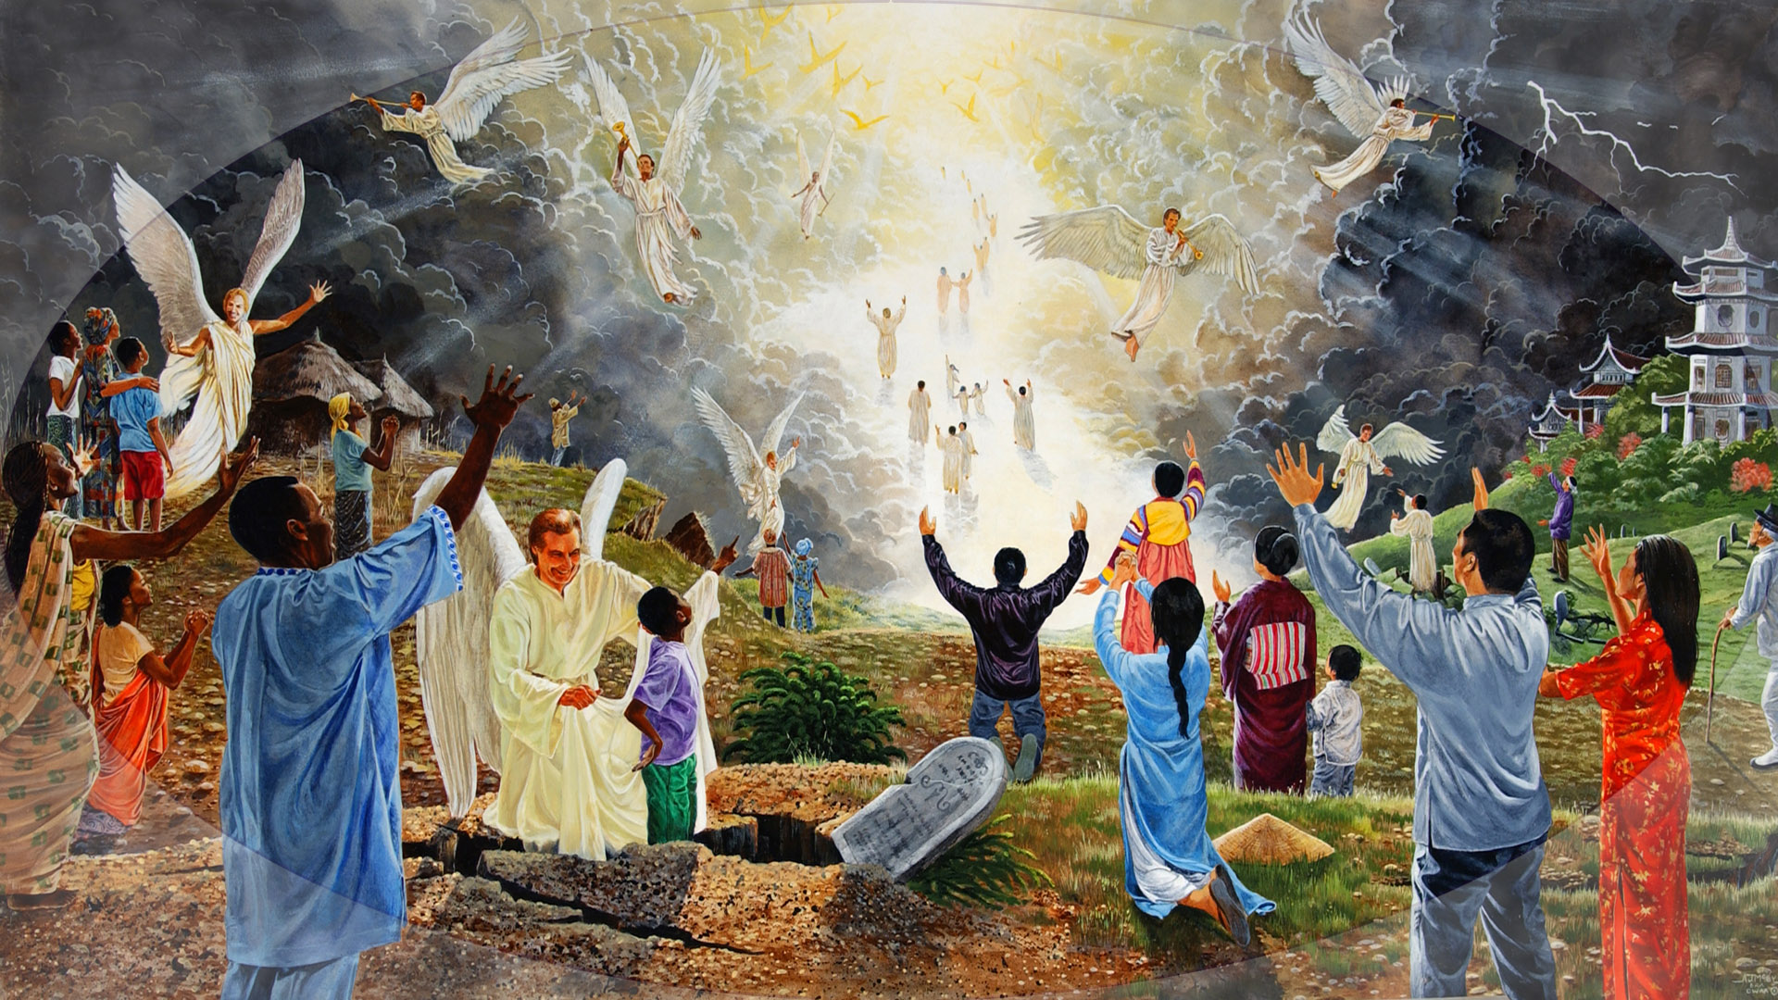
Notes:
Can you imagine, when Christ comes streaming down the corridor of the sky.
The earth is illuminated with the glory of God.
The ground rumbles, the buildings shake, the lightning flashes, the thunder crashes.
Ten thousand times ten thousand angels speed with haste to graves as righteous believers come forth.
Their bodies do not have the curse of sin.
There are no more deaf ears,
No more blind eyes,
No more arthritic limbs.
No more diseased bodies.
No more victims of cancer or heart disease.
As believers we are looking up, Christ is coming.
This is the most magnificent event in the heavens.
Instantly, our mortal bodies which are subject to disease and death, receive immortality.
What a day! Christ’s comes. What a day!
Instantly we are transformed.
Instantly we are changed.
New life pulsates through our bodies. We radiate with health and joy and gladness and happiness.
As Christ descends in glory we sing His praises as our bodies are changed from corruptible to the incorruptible.

Slide 25
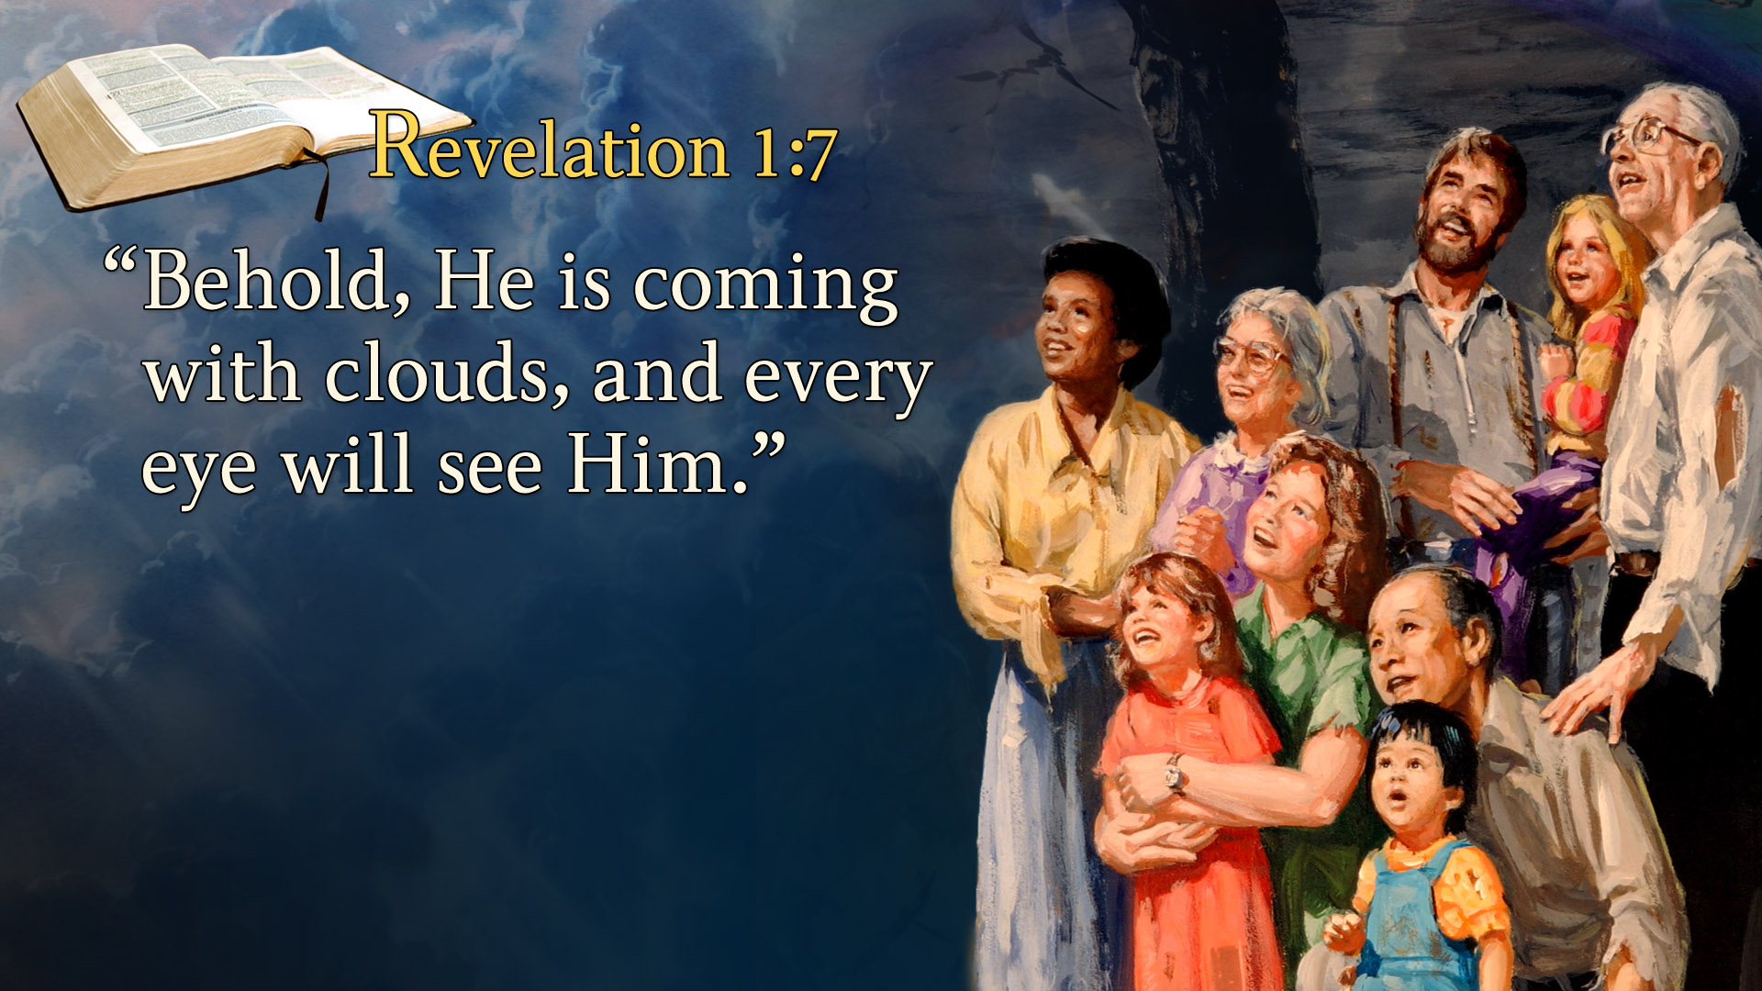
Adiyisɛm 22:12 - ASWDC
12. Hwɛ, mereba ntɛm, na mekura m’akatua sɛ mede merebɛma obiara sɛdeɛ n’adwuma teɛ.

Slide 26
WE KNOW THAT WE WILL SEE HIM AS HE IS.
Not as a traveling teacher walking the dusty roads of Galilee and Judea.

Slide 27
Mateo 16:27 - ASWDC
27. Na Onipa Ba no de n’agya animuonyam ne n’abɔfoɔ na ɛbɛba; ɛno na ɔbɛtua onipa biara ka sɛdeɛ ne nneyɛɛ teɛ.

Slide 28
Notes:
Can you imagine, when Christ comes streaming down the corridor of the sky.
The earth is illuminated with the glory of God.
The ground rumbles, the buildings shake, the lightning flashes, the thunder crashes.
Ten thousand times ten thousand angels speed with haste to graves as righteous believers come forth.
Their bodies do not have the curse of sin.
There are no more deaf ears,
No more blind eyes,
No more arthritic limbs.
No more diseased bodies.
No more victims of cancer or heart disease.
As believers we are looking up, Christ is coming.
This is the most magnificent event in the heavens.
Instantly, our mortal bodies which are subject to disease and death, receive immortality.
What a day! Christ’s comes. What a day!
Instantly we are transformed.
Instantly we are changed.
New life pulsates through our bodies. We radiate with health and joy and gladness and happiness.
As Christ descends in glory we sing His praises as our bodies are changed from corruptible to the incorruptible.

Slide 29
WE KNOW THAT WE WILL SEE HIM AS HE IS.
We will not see him as he was on the cross—beaten, bruised, abused, and more dead than alive.

Slide 30
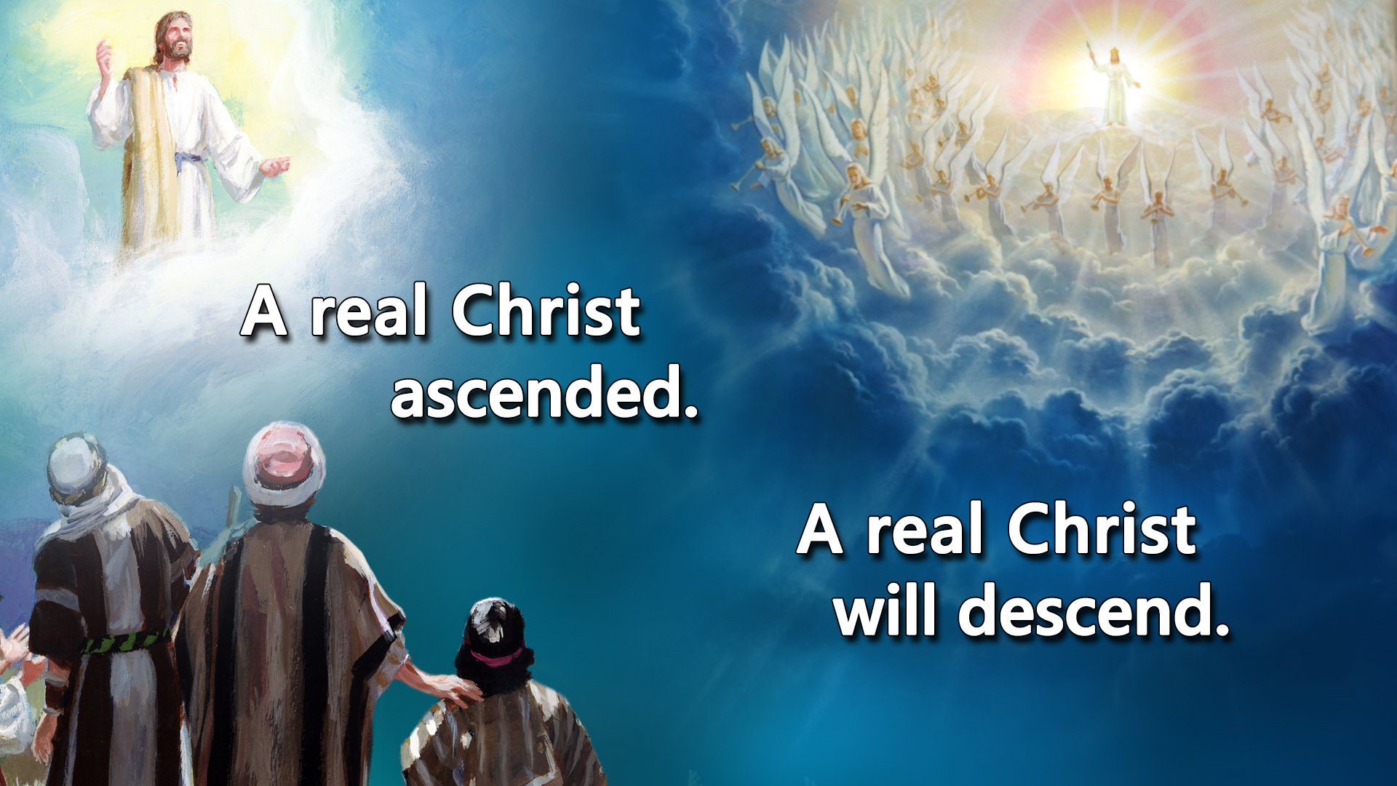
WE KNOW THAT WE WILL SEE HIM AS HE IS.
Not even as a miracle-worker who heals the sick and raises the dead.

Slide 31
WE KNOW THAT WE WILL SEE HIM AS HE IS.
Nor will we behold him as he was in the tomb—a corpse wrapped in a linen winding cloth.

Slide 32
WE KNOW THAT WE WILL SEE HIM AS HE IS.
We will see him as he is in heaven, Risen, ascended, victorious, the Lamb who is also a Lion, King of Kings, and Lord of Lords.

Slide 33
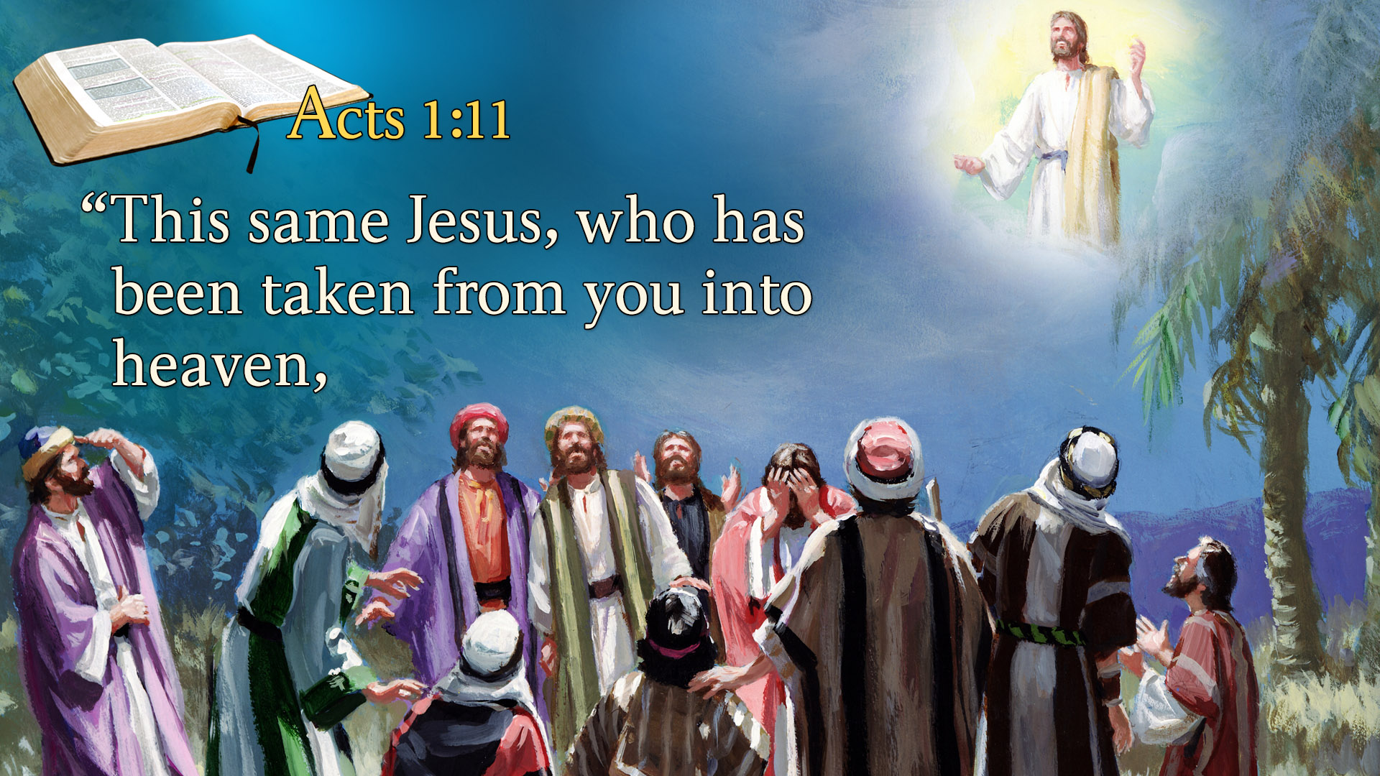
Notes:
Acts 1:11
“This same Jesus, who was taken up from you into heaven,

Slide 34
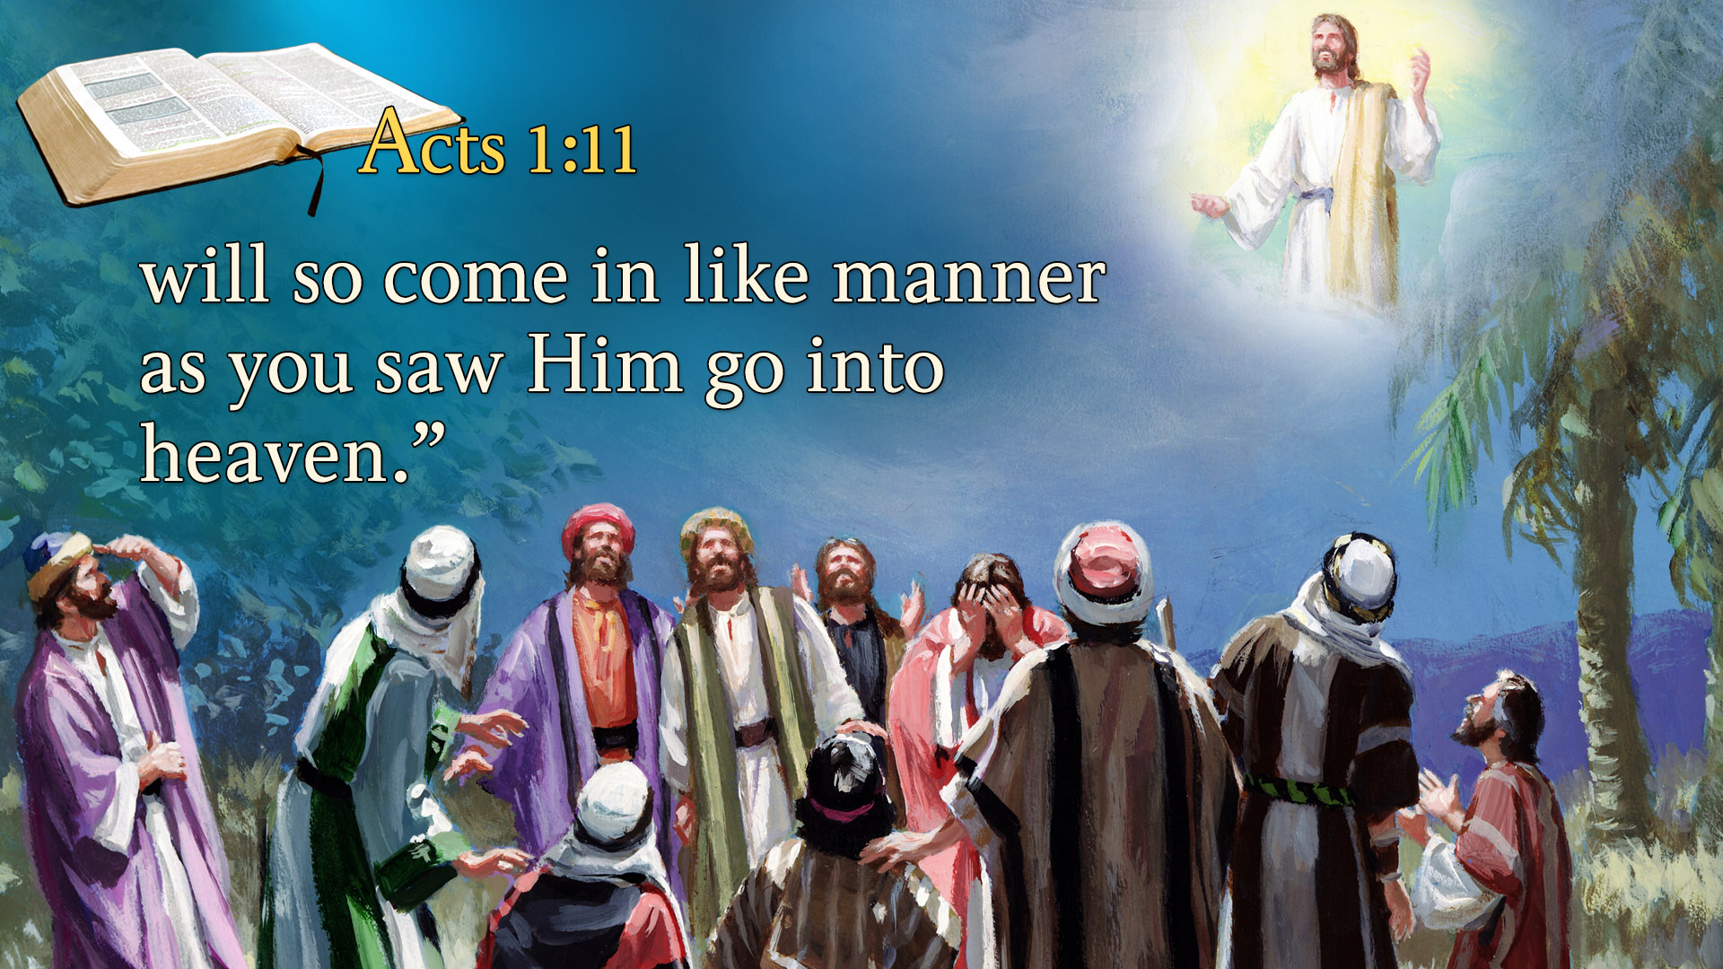
Notes:
Asomafoɔ 1:11 - ASWDC
11. na wɔkaa nso sɛ: Galilea mmarima, adɛn na mogyina ha rehwɛ soro yi? Yesu yi ara a wɔafa no mo nkyɛn kɔ soro yi, ɔbɛba saa ara, sɛdeɛ mohu no sɛ ɔrekɔ soro yi.
will so come in like manner as you saw Him go into heaven.”
As Jesus ascends higher and higher still. His disciples gaze up at Jesus in wonder. The Bible says,
“This same Jesus who is taken from you into heaven will come in like manner.”
They saw Him go. They will see Him come.

Slide 35
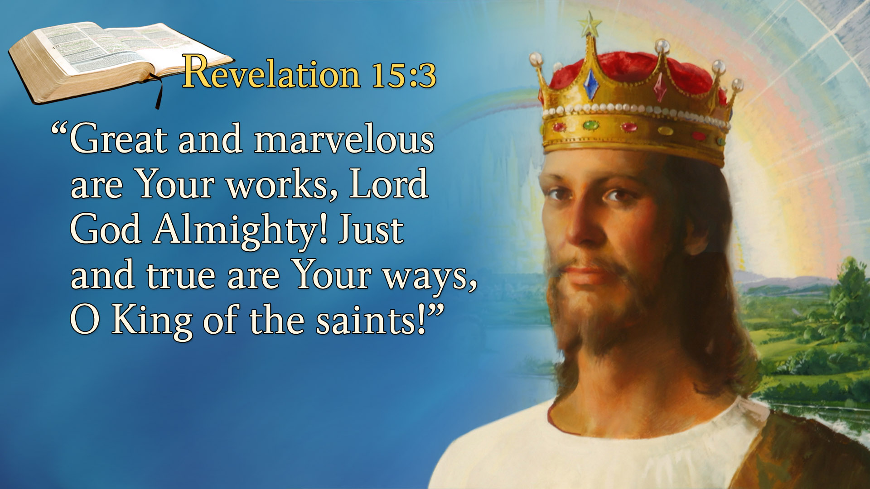
Notes:
Revelation 15:3
“Great and marvelous are Your works, Lord God Almighty! Just and true are Your ways, O King of the saints!”
We see the dead resurrected.
We see our brother, sister, our son or daughter, our husband or wife come out of the tomb with new glorious immortal bodies.
Angels present them to us again. We embrace with tears flowing down our cheeks. We ascend together.
Picture this scene—loved ones embracing.
Families are reunited.
This is the greatest drama of the ages.
We see loved ones coming out of the grave and we are singing, “Great and marvelous are your works, Lord God Almighty. Just and true are your ways”.
We see Him coming as King of King and Lord of Lords. We cry out.

Slide 36
WE KNOW THAT WE WILL SEE HIM AS HE IS.
Do not doubt for a moment that it is Jesus himself we will see.

Slide 37
WHEN WE SEE HIM, WE WILL BE LIKE HIM.
Ponder that thought for a moment “We will be like Jesus”.

Slide 38
WHEN WE SEE HIM, WE WILL BE LIKE HIM.
In this life we are being transformed into the image of Christ little by little, day by day, step by step, by the Spirit of God.

Slide 39
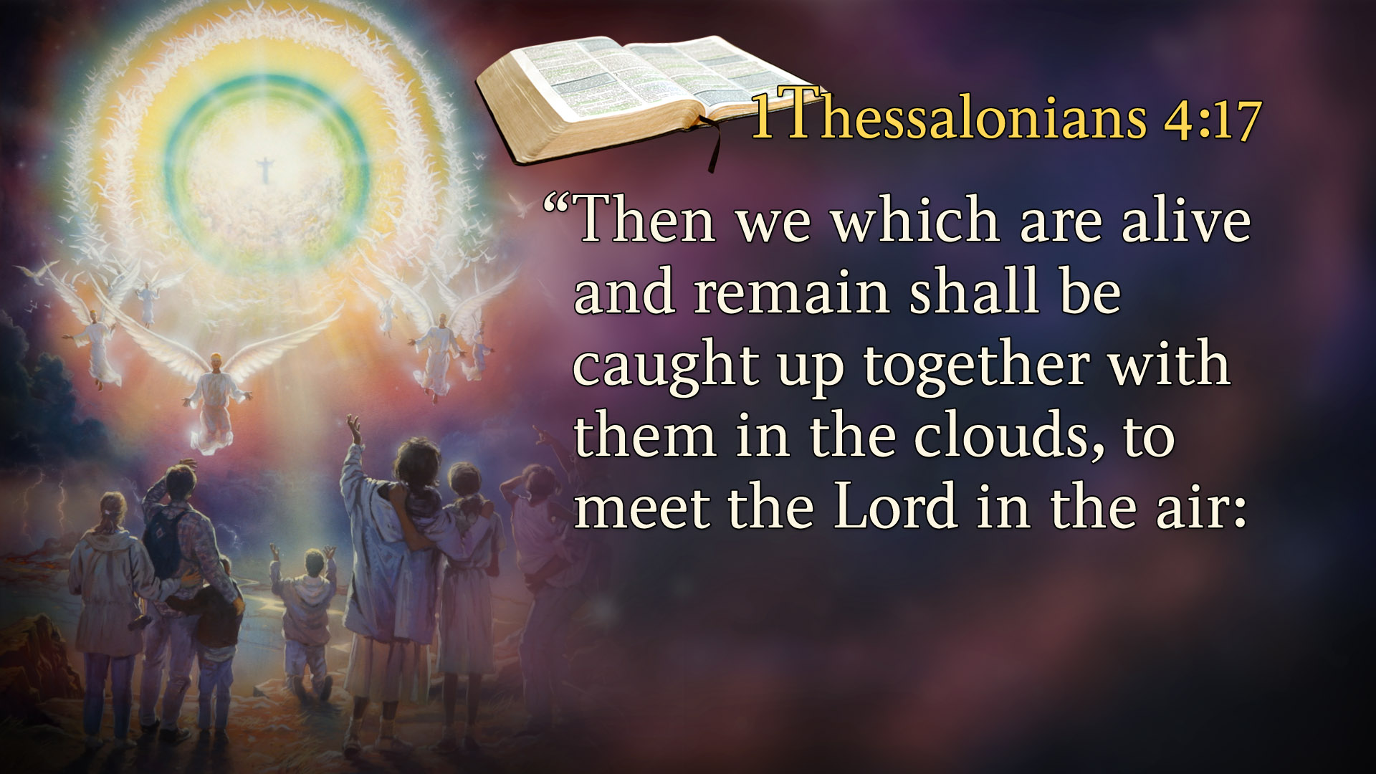
Notes:
1 Thessalonians 4:17
“Then we who are alive and remain shall be caught up together with them in the clouds to meet the Lord in the air.
Who are we going to meet?
The righteous dead who are resurrected.
The righteous dead who have been sleeping in their graves.
We will be caught up – “with them” in the clouds to meet the Lord in the air.

Slide 40
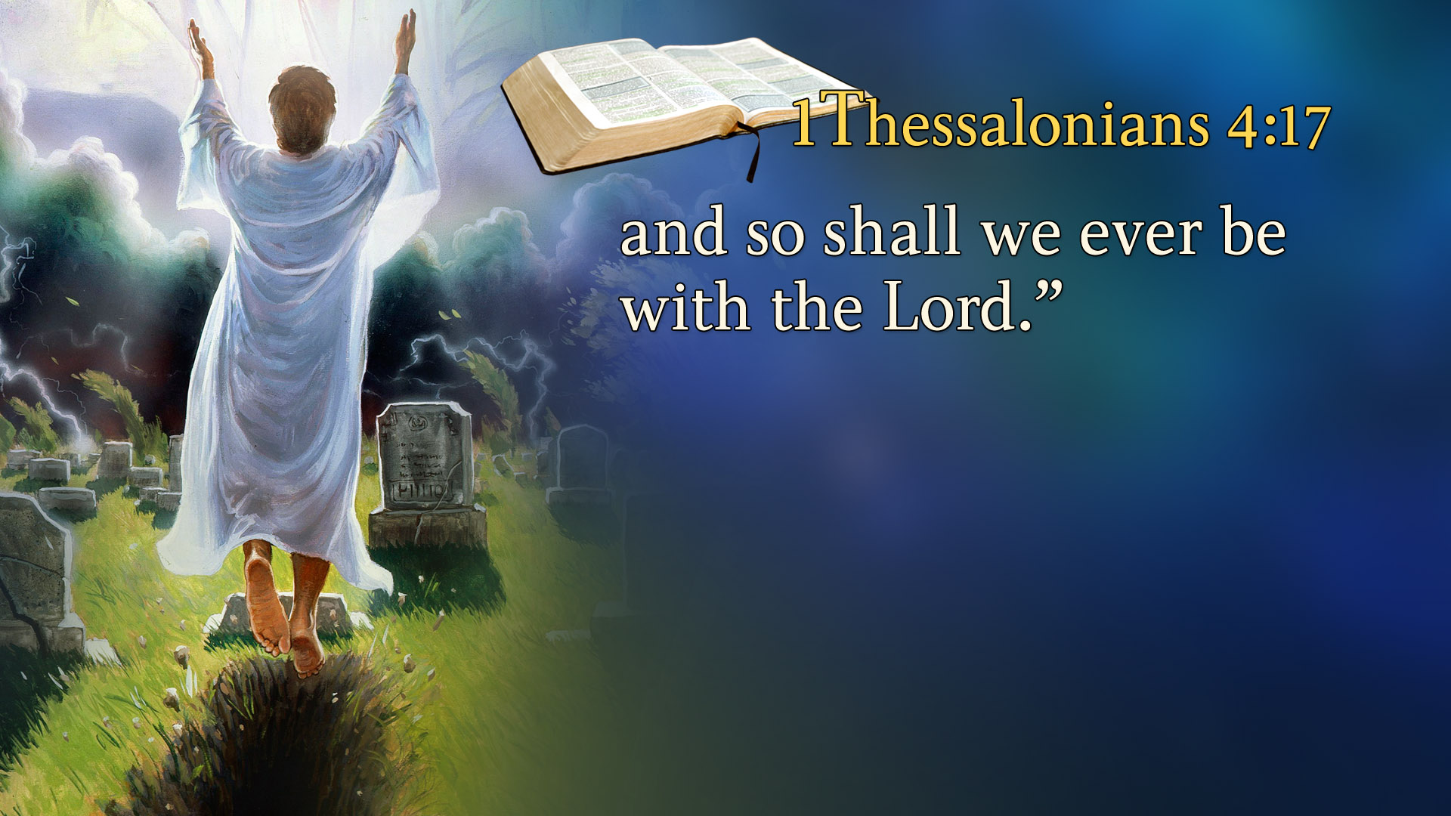
Notes:
And thus we shall always be with the Lord.”
Does Jesus come to live upon the earth at this time?
No. We don’t meet Him on earth.
We meet Him where? In the air.
The Bible says that:

Slide 41
WHEN WE SEE HIM, WE WILL BE LIKE HIM.
But the work is so slow and progress is so difficult, and it often seems as if we are going backwards and not forwards.

Slide 42
HOW CAN I LIVE A HOLY LIFE?

Slide 43
1. REPENTANCE
Asomafoɔ 2:37-38 - ASWDC
37. Na wɔteeɛ no, ɛwowɔɔ wɔn akoma mu, na wɔka kyerɛɛ Petro ne asomafoɔ a aka no sɛ: Anuanom, yɛnyɛ dɛn?
38. Na Petro see wɔn sɛ: Monsakyera mo adwene, na mo nyinaa mma wɔmmɔ mo asu Yesu Kristo din mu, mma mo bɔne fakyɛ, na mobɛnya Honhom Kronkron akyɛdeɛ no.

Slide 44
2. CONFESSION OF SIN
1 Yohane 1:9 - ASWDC
9. Sɛ yɛka yɛn bɔne kyerɛ a, ɔyɛ nokwafoɔ ne teneneeni sɛ ɔde yɛn bɔne bɛkyɛ yɛn, na wate yɛn ho afiri deɛ ɛntene nyinaa ho.

Slide 45
2. CONFESSION OF SIN
Romafoɔ 10:9-10 - ASWDC
9. Na sɛ wode w’ano pae mu ka sɛ Yesu ne Awurade, na wode w’akoma gye di sɛ Onyankopɔn anyane no afiri awufoɔ mu a, wɔbɛgye wo nkwa.
10. Na akoma na wɔde gye di kɔ tenenee mu, na ano na wɔde pae mu ka kɔ nkwagyeɛ mu.

Slide 46
3. FORGIVENESS
Efesofoɔ 4:30-32 - ASWDC
30. Na monnho Nyankopɔn Honhom Kronkron a wɔde no asɔ mo ano ama ɔgyeɛ da no werɛ.
31. Momma wɔnyi yeadie nyinaa ne koko bɔne ne abufuo ne ano kurokuro ne abususɛm, ɛne bɔnepɛ nyinaa mfiri mo mu.

Slide 47
3. FORGIVENESS
Efesofoɔ 4:32 - ASWDC
32. Na momma mo yam nyɛ yie na ɛnhyehye mo mmema mo ho, momfa nkyekyɛ mo ho, sɛdeɛ Onyankopɔn nam Kristo so de kyɛɛ mo no.

Slide 48
4. ASK FOR HOLY LIFE DAILY IN DEVOTION
Luka 11:13 - ASWDC
13. Na sɛ mo a moyɛ abɔnefoɔ nim sɛdeɛ mode nnepa ma mo mma a, mprɛ ahe ara na mo Agya a ɔwɔ soro no remfa Honhom Kronkron mma wɔn a wɔbisa no?

Slide 49
5. BELIEVE THAT YOU ARE HOLY
2 Korintofoɔ 6:16 - ASWDC
16. Na baakoyɛ bɛn na Nyankopɔn asɔrefie ne abosom wɔ? Na yɛyɛ Onyankopɔn a ɔte aseɛ no asɔrefie, sɛdeɛ Onyankopɔn aka sɛ: Mɛtena wɔn mu, na manante wɔn mu, na mayɛ wɔn Nyankopɔn, na wɔayɛ me man.

Slide 50
6. WILLFUL OBEDIENCE
Asomafoɔ 5:32 - ASWDC
32. Aane, yɛn, yɛyɛ yeinom ho adansefoɔ, na saa ara nso na Honhom Kronkron a Onyankopɔn de ma wɔn a wɔtie no no yɛ.

Slide 51
6. WILLFUL OBEDIENCE
Luka 6:46 - ASW
46. Na adɛn na mofrɛ me: Awurade, Awurade, na monyɛ deɛ meseɛ?

Slide 52
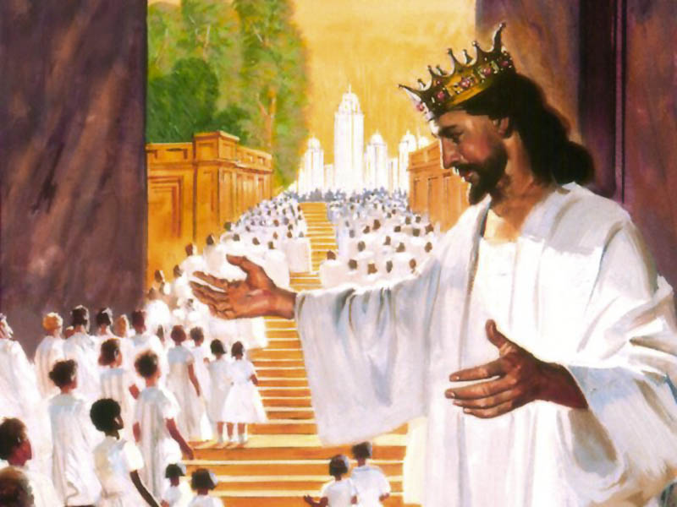

Slide 53
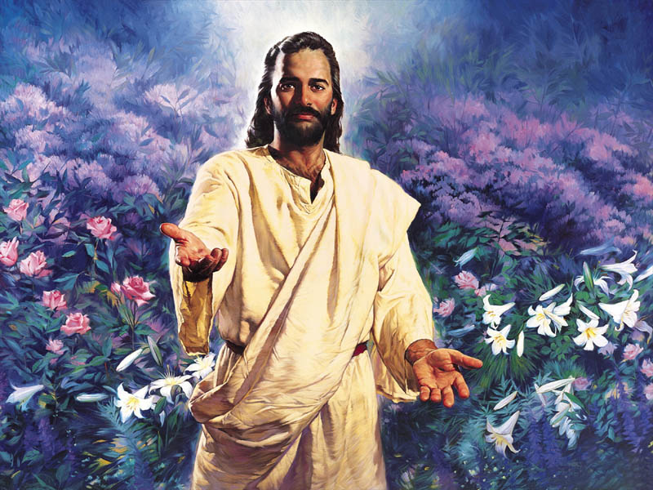

Slide 54
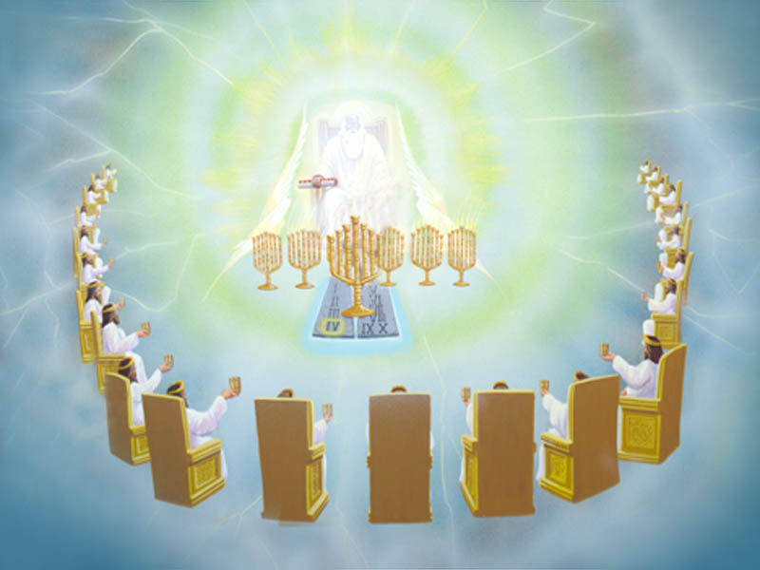

Slide 55
Hymn no. 287 “Softly and Tenderly”
Verse 1:
Softly and tenderly Jesus is calling,
Calling for you and for me;
At the heart’s portal He’s waiting and watching,
Watching for you and for me.

Slide 56
Hymn no. 287 “Softly and Tenderly”
Refrain:
Come home, (Come home),
Come home, (come home),
Ye who are weary, come home;
Earnestly, tenderly Jesus is calling,
Calling, O sinner, come home!

Slide 57
Hymn no. 287 “Softly and Tenderly”
Verse 2:
Why should we tarry when Jesus is pleading,
Pleading for you and for me?
Why should we linger and heed not His mercies,
Mercies for you and for me?

Slide 58
Hymn no. 287 “Softly and Tenderly”
Refrain:
Come home, (Come home),
Come home, (come home),
Ye who are weary, come home;
Earnestly, tenderly Jesus is calling,
Calling, O sinner, come home!

Slide 59
Hymn no. 287 “Softly and Tenderly”
Verse 3:
Think of the wonderful love He has promised,
Promised for you and for me;
Though we have sinned, He has mercy and pardon,
Pardon for you and for me.

Slide 60
Hymn no. 287 “Softly and Tenderly”
Refrain:
Come home, (Come home),
Come home, (come home),
Ye who are weary, come home;
Earnestly, tenderly Jesus is calling,
Calling, O sinner, come home!

